Slide 1
Find minimum SOP 5 Variables Examples
2023.04.10 Mon
Lee Jua (lja0747@g.skku.edu)
Im Hyeon Seong (lhs8859@gmail.com)

Slide 2
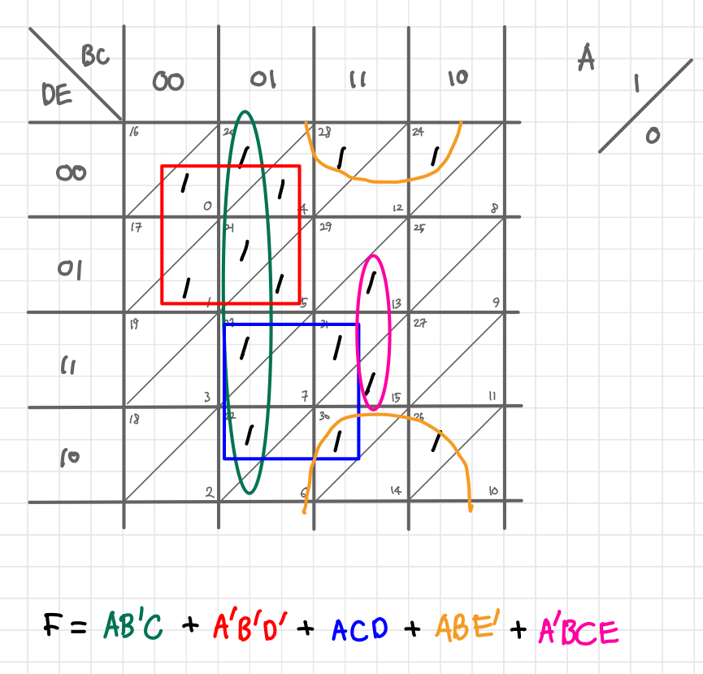
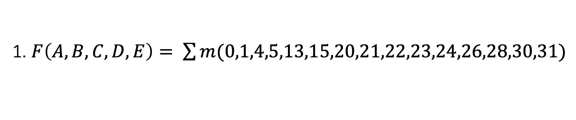
1. $F\left(A,B,C,D,E\right)= \sum{m(0,1,4,5,13,15,20,21,22,23,24,26,28,30,31)}$

Slide 3
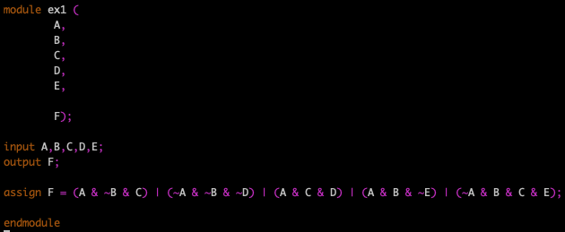
1. $F\left(A,B,C,D,E\right)= \sum{m(0,1,4,5,13,15,20,21,22,23,24,26,28,30,31)}$
Minterm
Don’t care
0
1
2
3
4
5
6
7
8
9
10
11
12
13
14
15
16
17
18
19
20
21
22
23
24
25
26
27
28
29
30
31

Slide 4
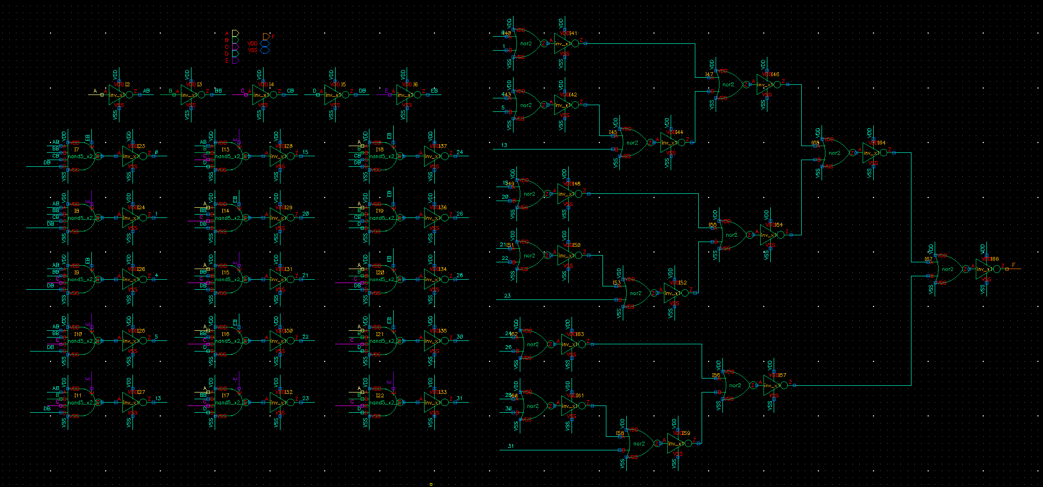
1. $F\left(A,B,C,D,E\right)= \sum{m(0,1,4,5,13,15,20,21,22,23,24,26,28,30,31)}$
Before Minimize

Slide 5
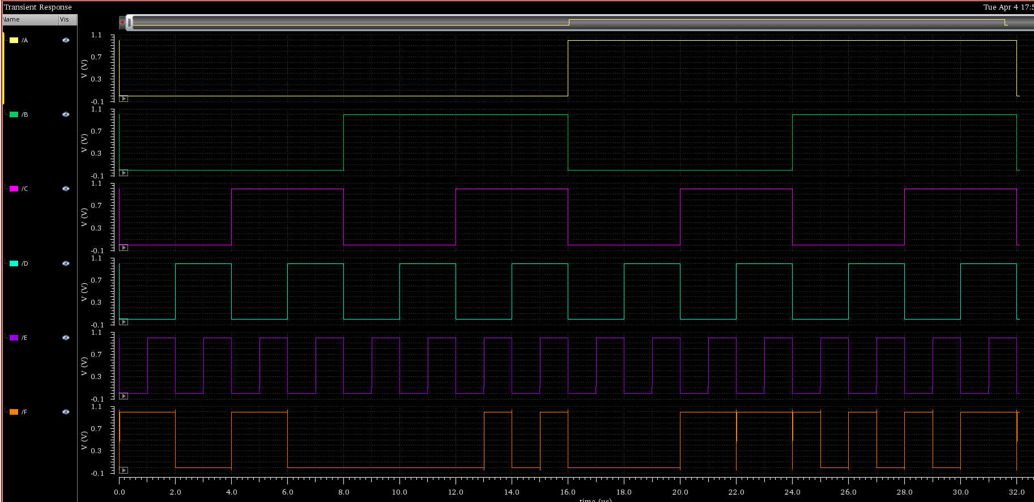
1. $F\left(A,B,C,D,E\right)= \sum{m(0,1,4,5,13,15,20,21,22,23,24,26,28,30,31)}$
0
1
2
3
4
5
6
7
8
9
10
11
12
13
14
15
16
17
18
19
20
21
22
23
24
25
26
27
28
29
30
31

Slide 6
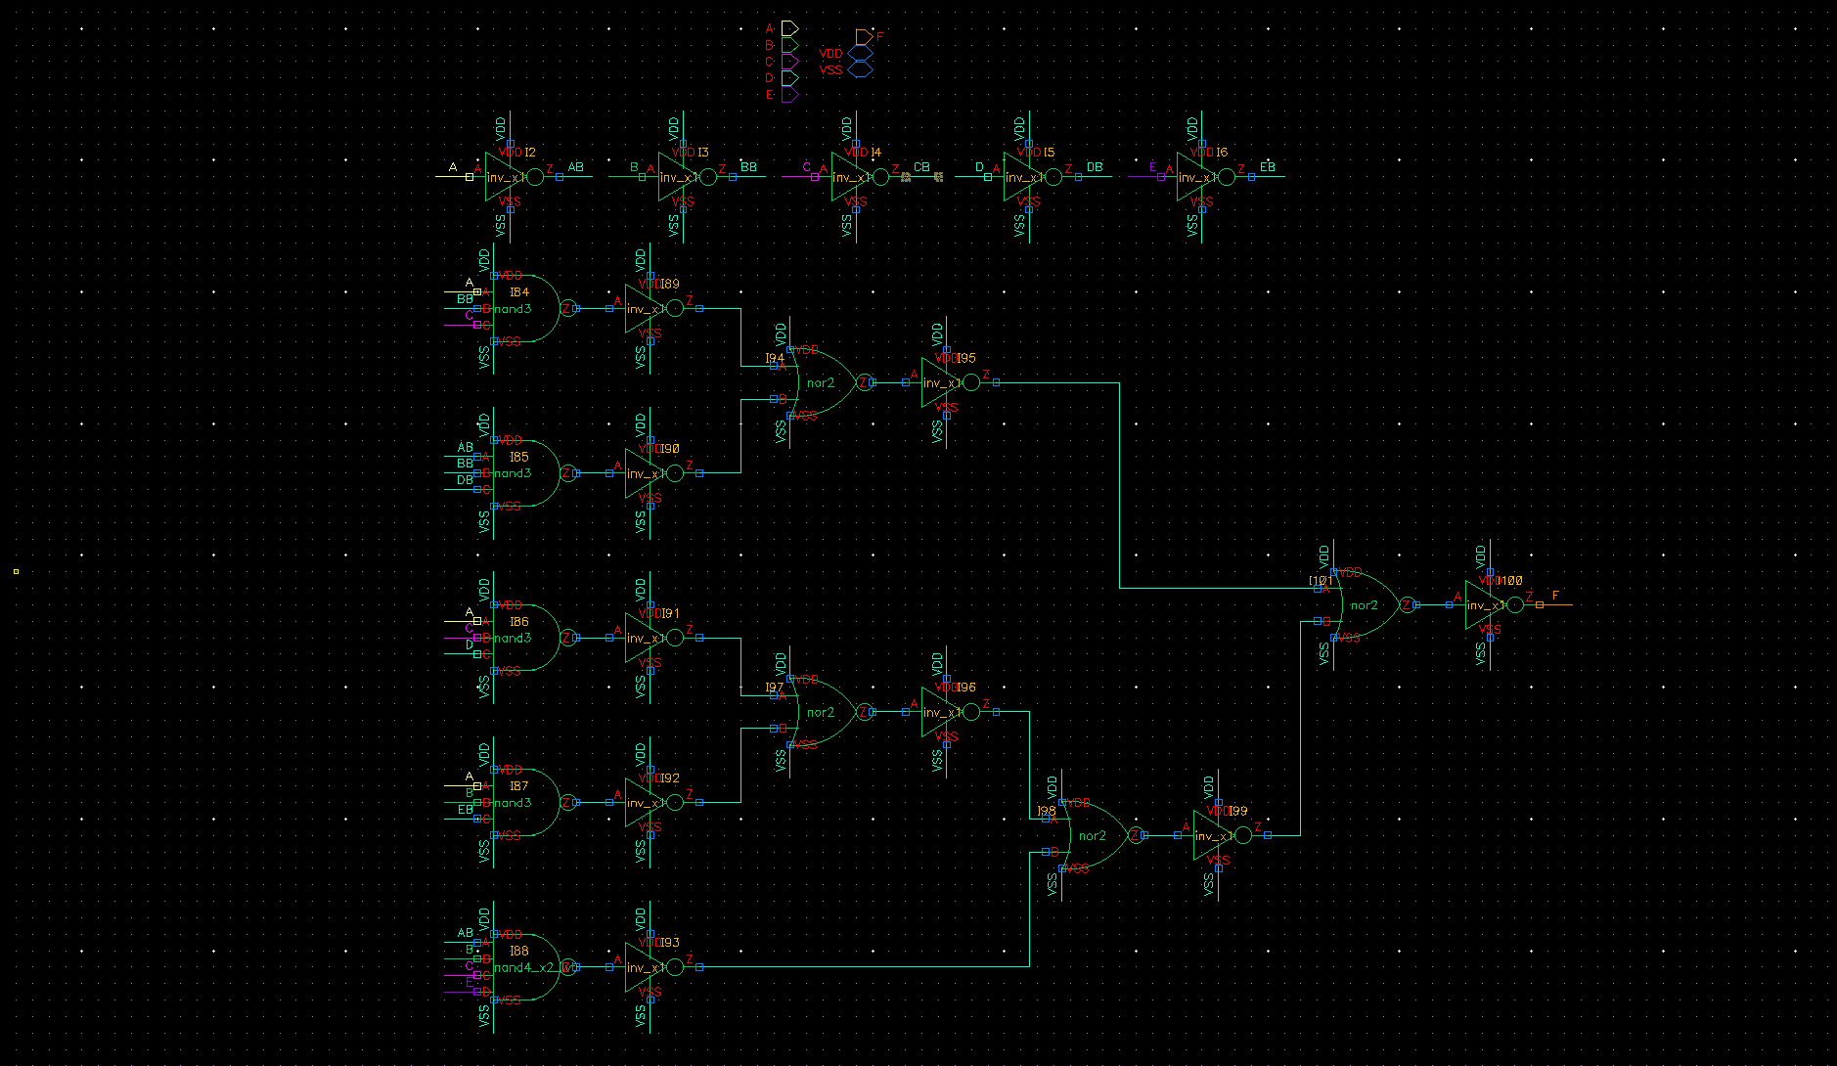
1. $F\left(A,B,C,D,E\right)= \sum{m(0,1,4,5,13,15,20,21,22,23,24,26,28,30,31)}$
After Minimize

Slide 7
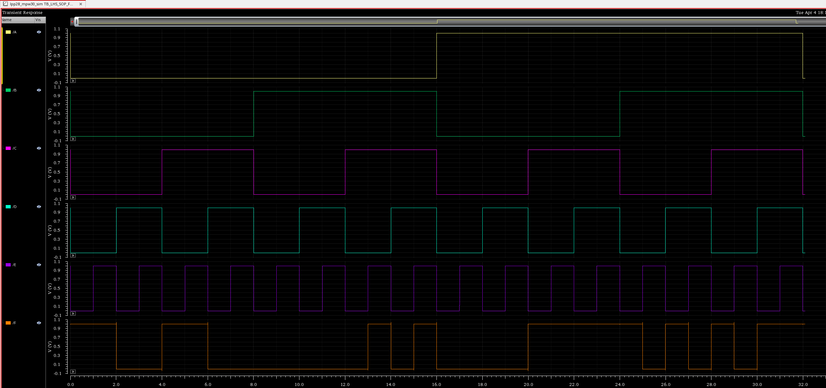
1. $F\left(A,B,C,D,E\right)= \sum{m(0,1,4,5,13,15,20,21,22,23,24,26,28,30,31)}$
0
1
2
3
4
5
6
7
8
9
10
11
12
13
14
15
16
17
18
19
20
21
22
23
24
25
26
27
28
29
30
31

Slide 8
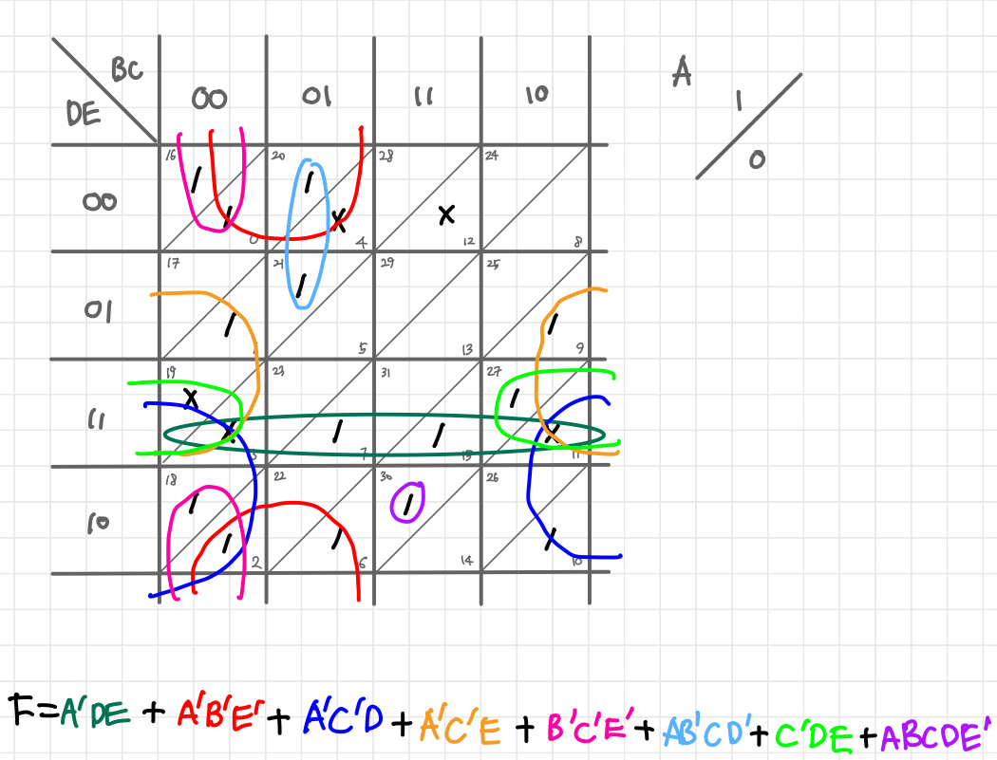
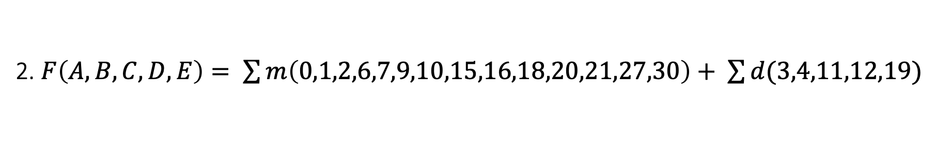
2. $F\left(A,B,C,D,E\right)= \sum{m\left(0,1,2,6,7,9,10,15,16,18,20,21,27,30\right)+ \sum{d(3,4,11,12,19)}}$

Slide 9
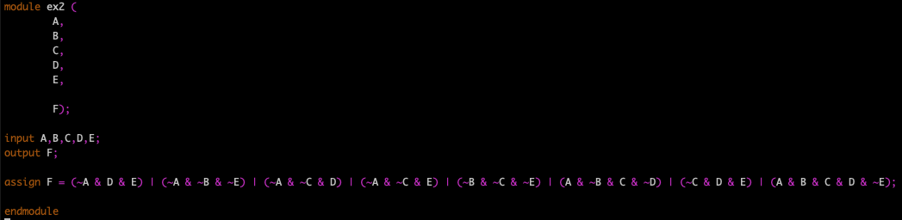
2. $F\left(A,B,C,D,E\right)= \sum{m\left(0,1,2,6,7,9,10,15,16,18,20,21,27,30\right)+ \sum{d(3,4,11,12,19)}}$
Minterm
Don’t care
0
1
2
3
4
5
6
7
8
9
10
11
12
13
14
15
16
17
18
19
20
21
22
23
24
25
26
27
28
29
30
31

Slide 10
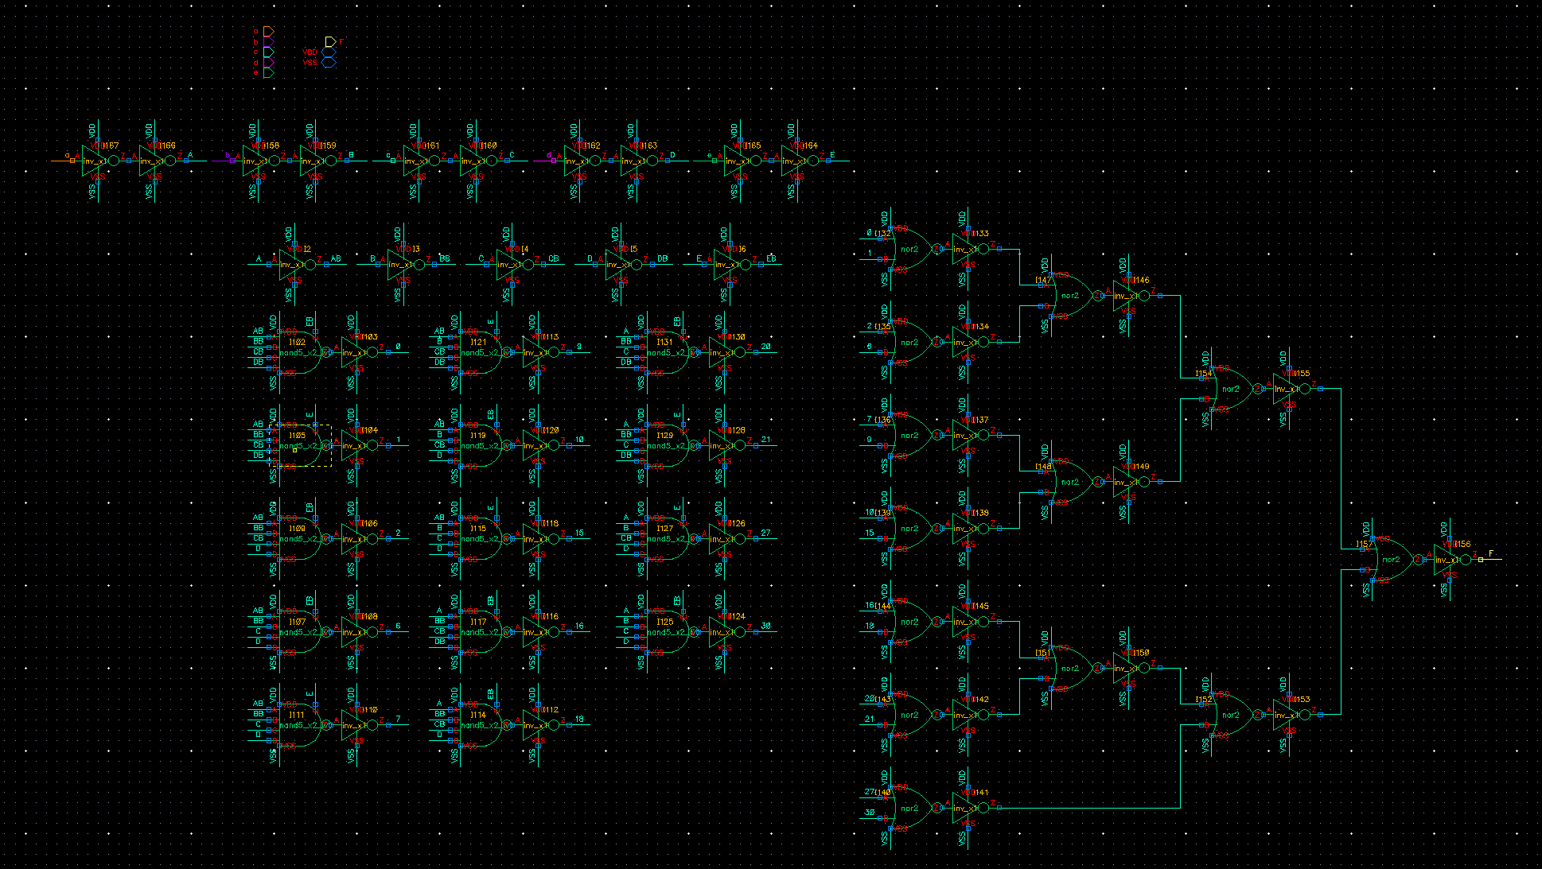
2. $F\left(A,B,C,D,E\right)= \sum{m\left(0,1,2,6,7,9,10,15,16,18,20,21,27,30\right)+ \sum{d(3,4,11,12,19)}}$
Before Minimize

Slide 11
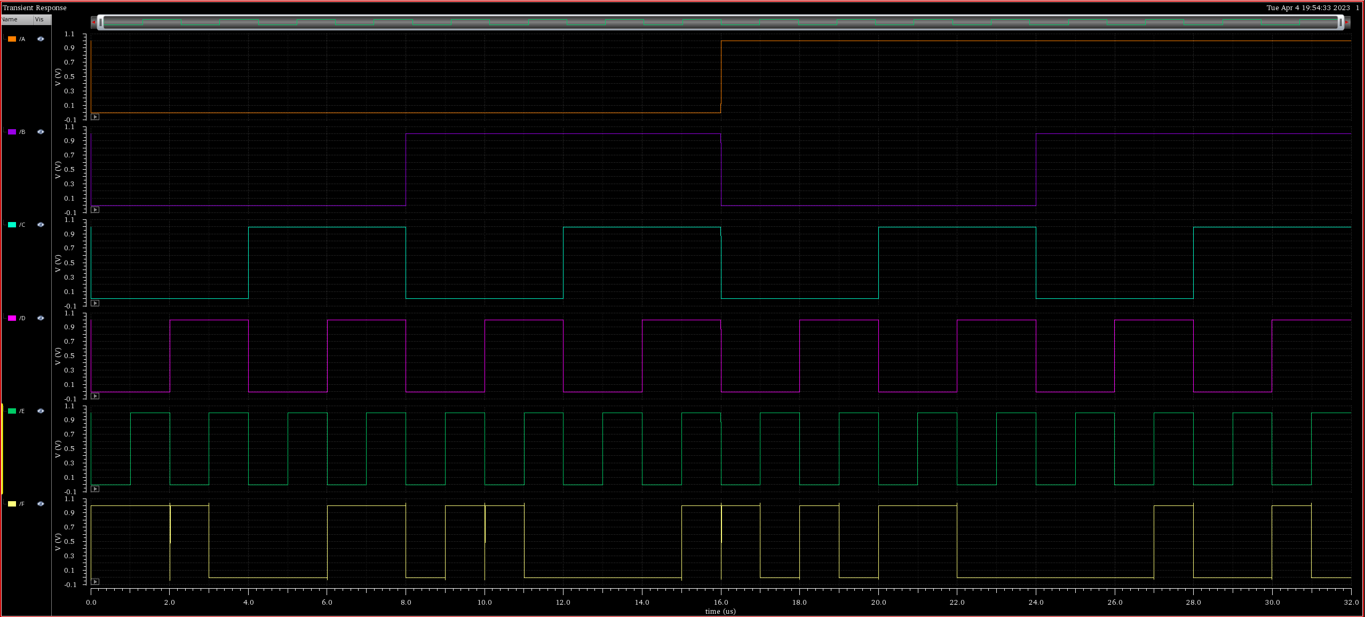
2. $F\left(A,B,C,D,E\right)= \sum{m\left(0,1,2,6,7,9,10,15,16,18,20,21,27,30\right)+ \sum{d(3,4,11,12,19)}}$
0
1
2
3
4
5
6
7
8
9
10
11
12
13
14
15
16
17
18
19
20
21
22
23
24
25
26
27
28
29
30
31

Slide 12
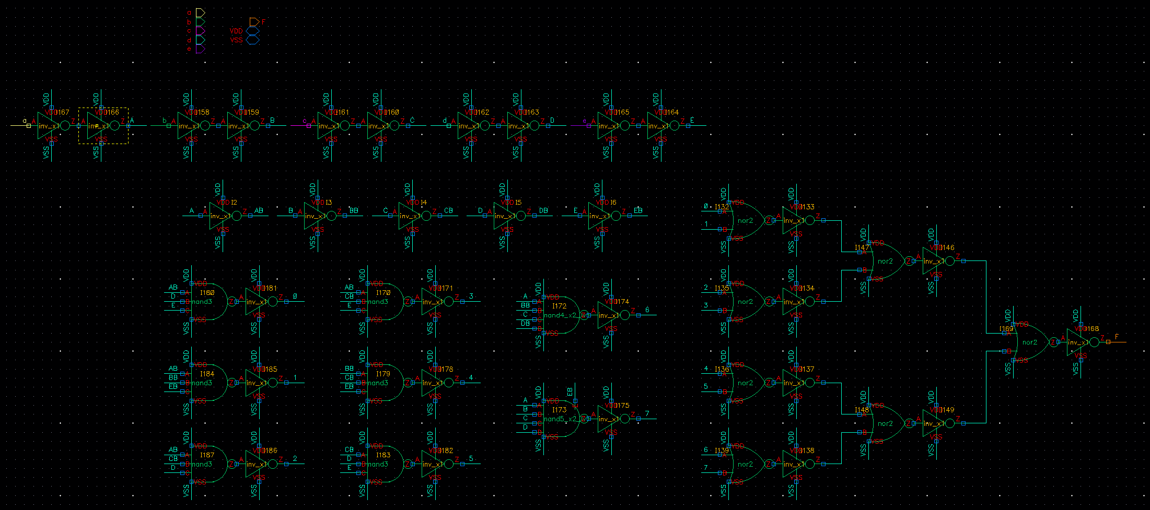
2. $F\left(A,B,C,D,E\right)= \sum{m\left(0,1,2,6,7,9,10,15,16,18,20,21,27,30\right)+ \sum{d(3,4,11,12,19)}}$
After Minimize (with Don’t care term)

Slide 13
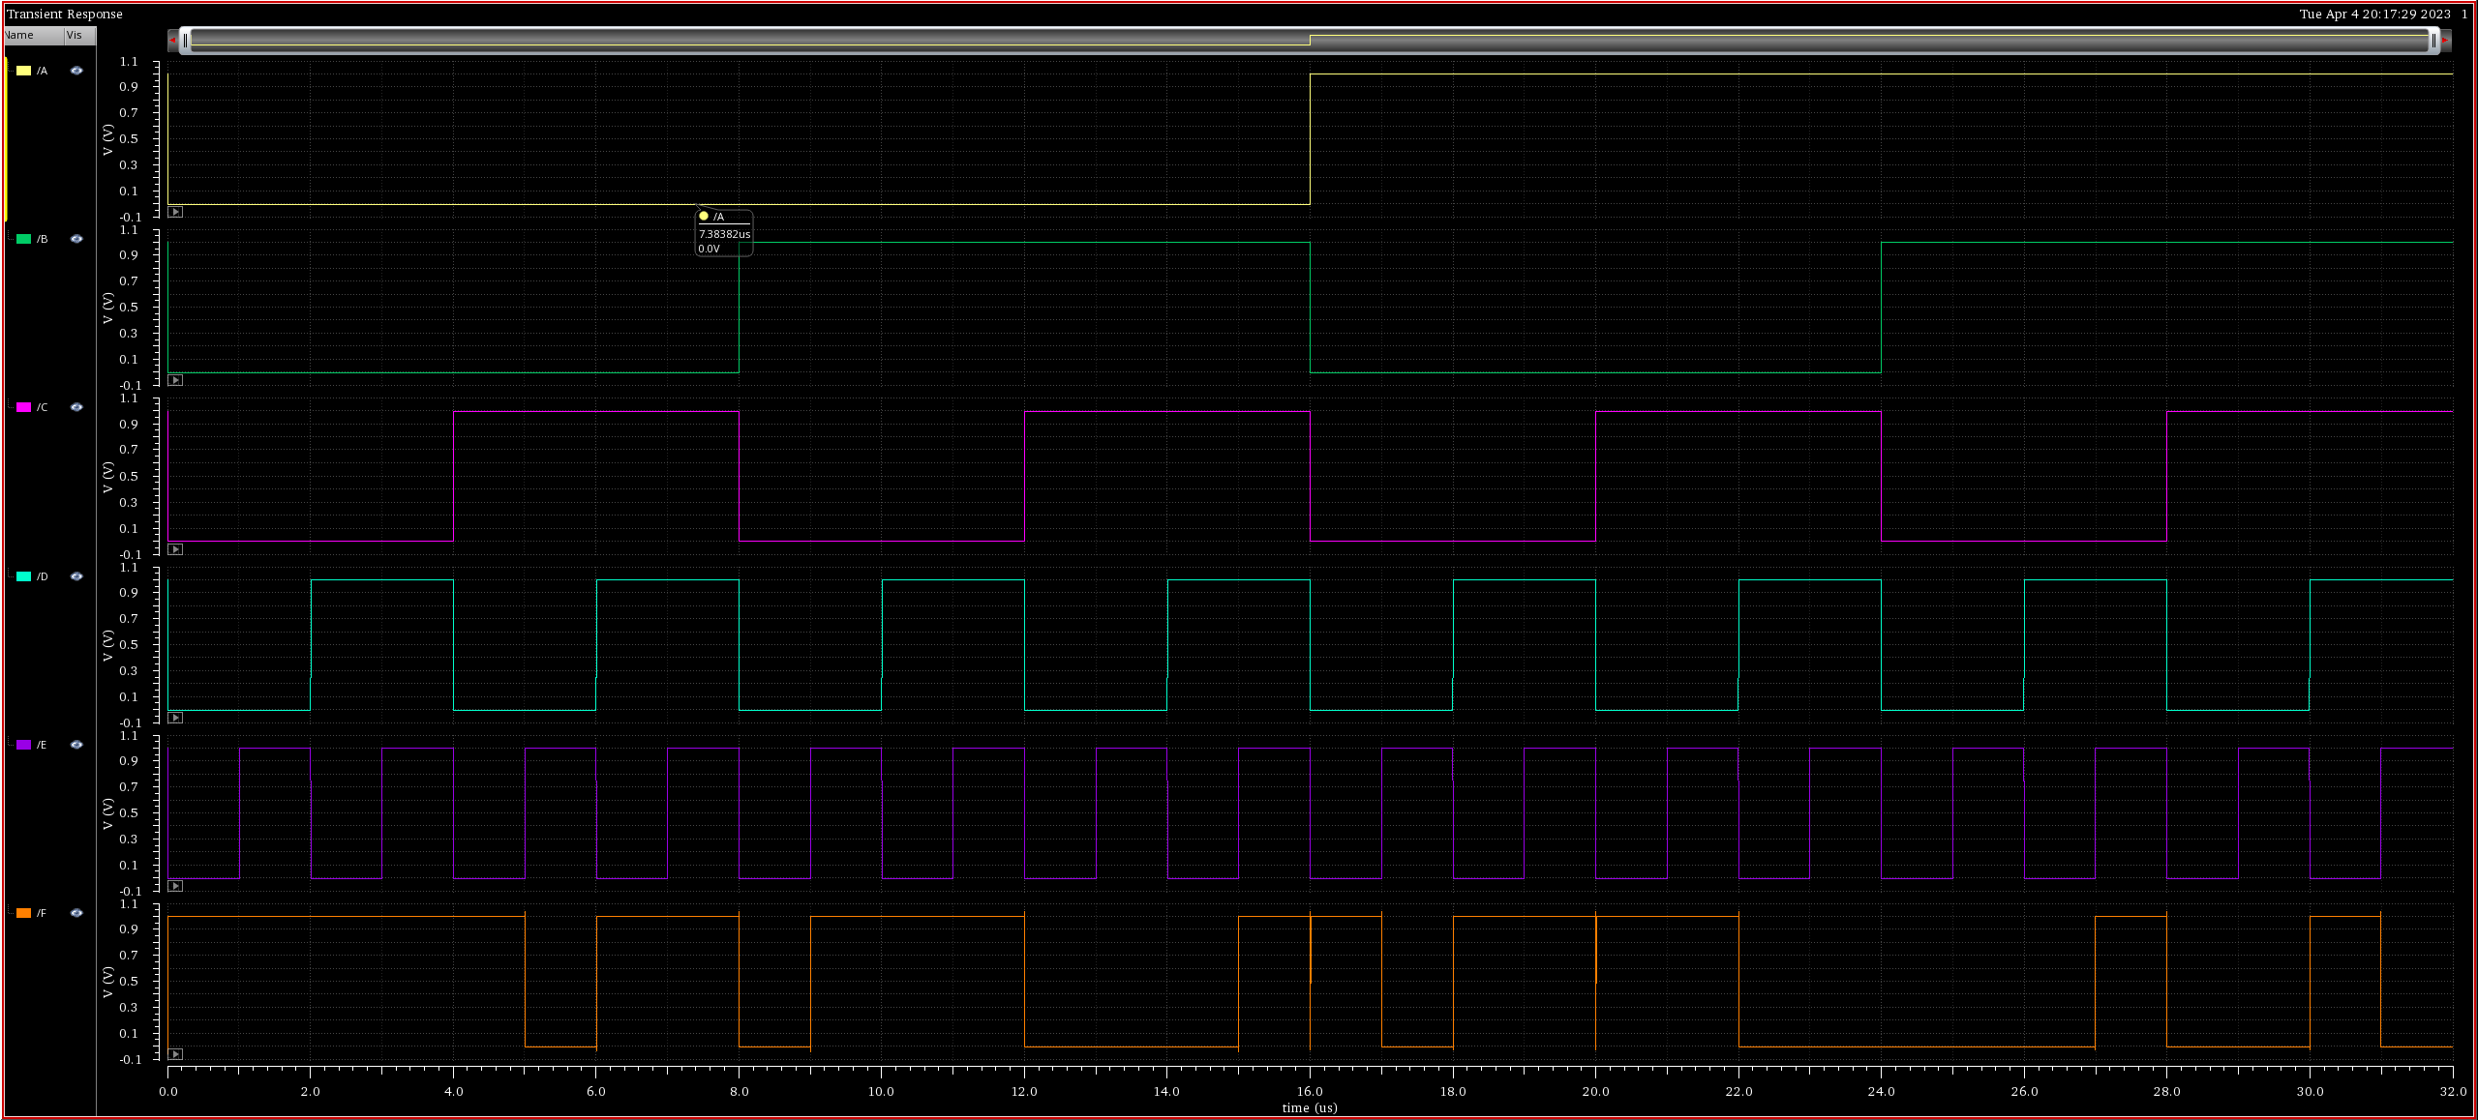
2. $F\left(A,B,C,D,E\right)= \sum{m\left(0,1,2,6,7,9,10,15,16,18,20,21,27,30\right)+ \sum{d(3,4,11,12,19)}}$
0
1
2
3
4
5
6
7
8
9
10
11
12
13
14
15
16
17
18
19
20
21
22
23
24
25
26
27
28
29
30
31

Slide 14
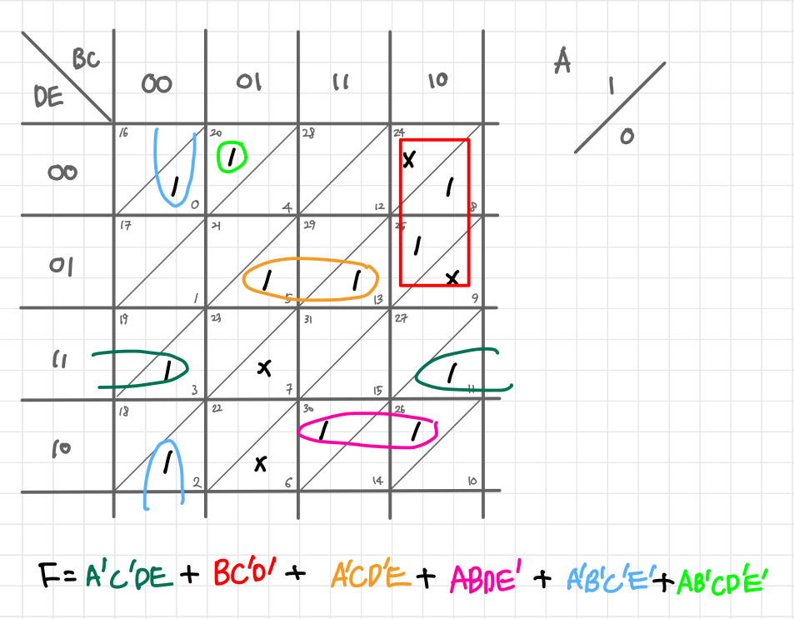
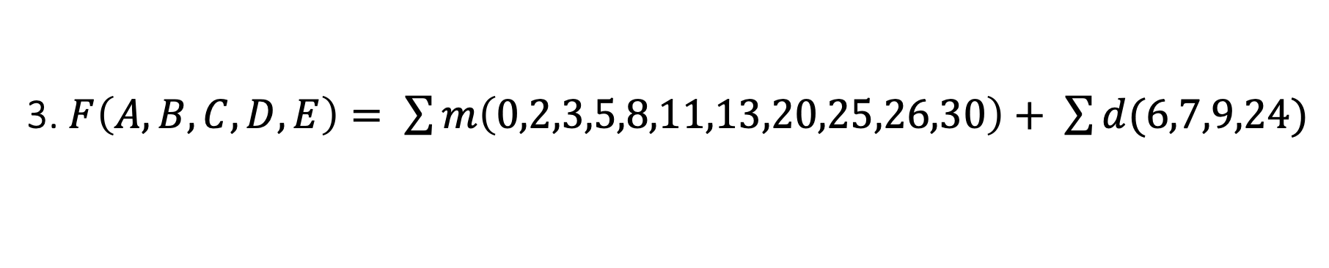
3. $F\left(A,B,C,D,E\right)= \sum{m\left(0,2,3,5,8,11,13,20,25,26,30\right)+ \sum{d(6,7,9,24)}}$

Slide 15
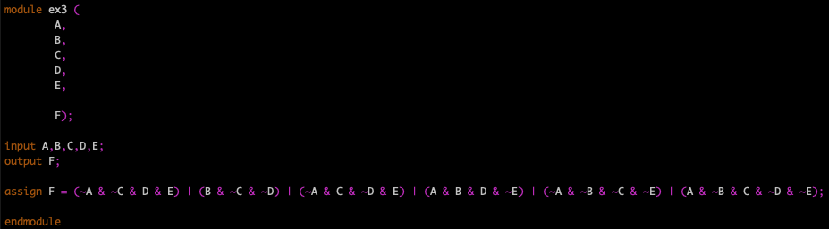
3. $F\left(A,B,C,D,E\right)= \sum{m\left(0,2,3,5,8,11,13,20,25,26,30\right)+ \sum{d(6,7,9,24)}}$
Minterm
Don’t care
0
1
2
3
4
5
6
7
8
9
10
11
12
13
14
15
16
17
18
19
20
21
22
23
24
25
26
27
28
29
30
31

Slide 16
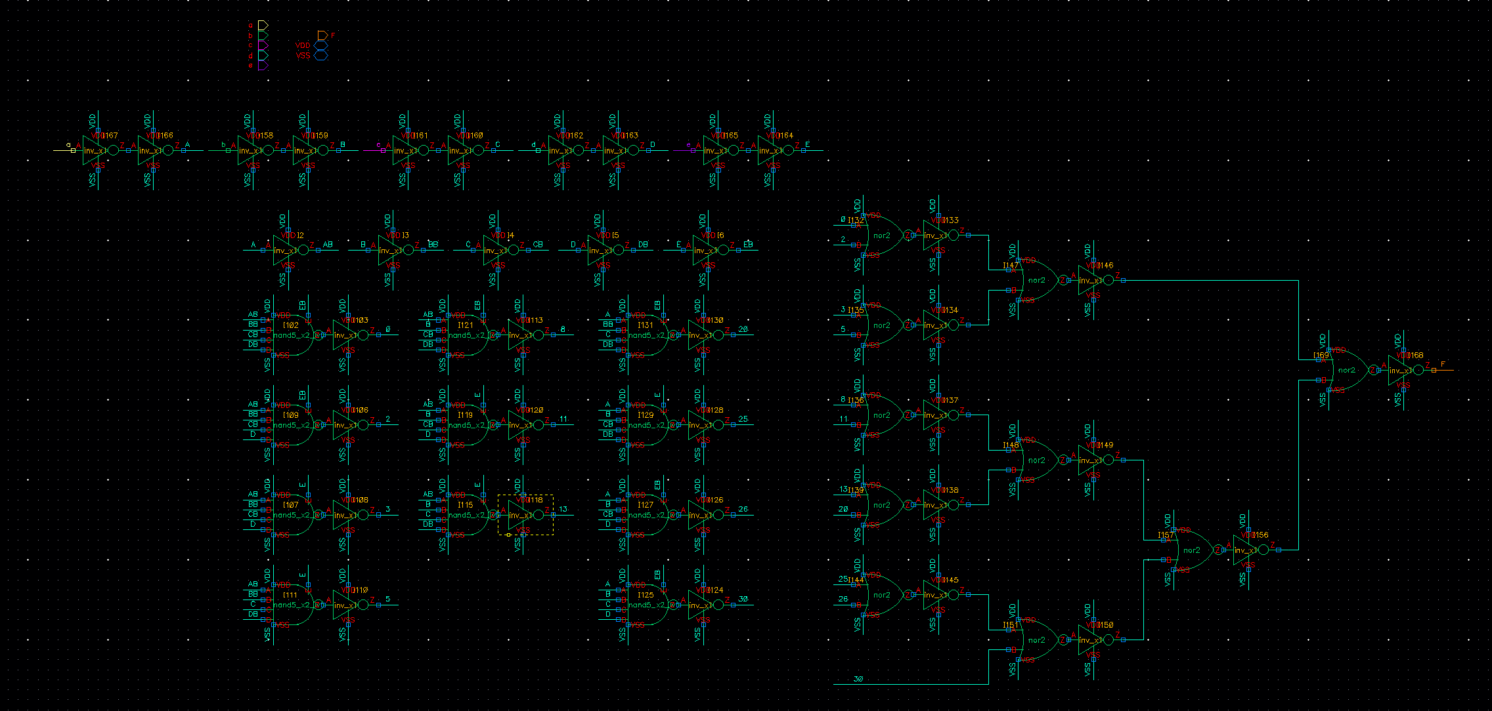
3. $F\left(A,B,C,D,E\right)= \sum{m\left(0,2,3,5,8,11,13,20,25,26,30\right)+ \sum{d(6,7,9,24)}}$
Before Minimize

Slide 17
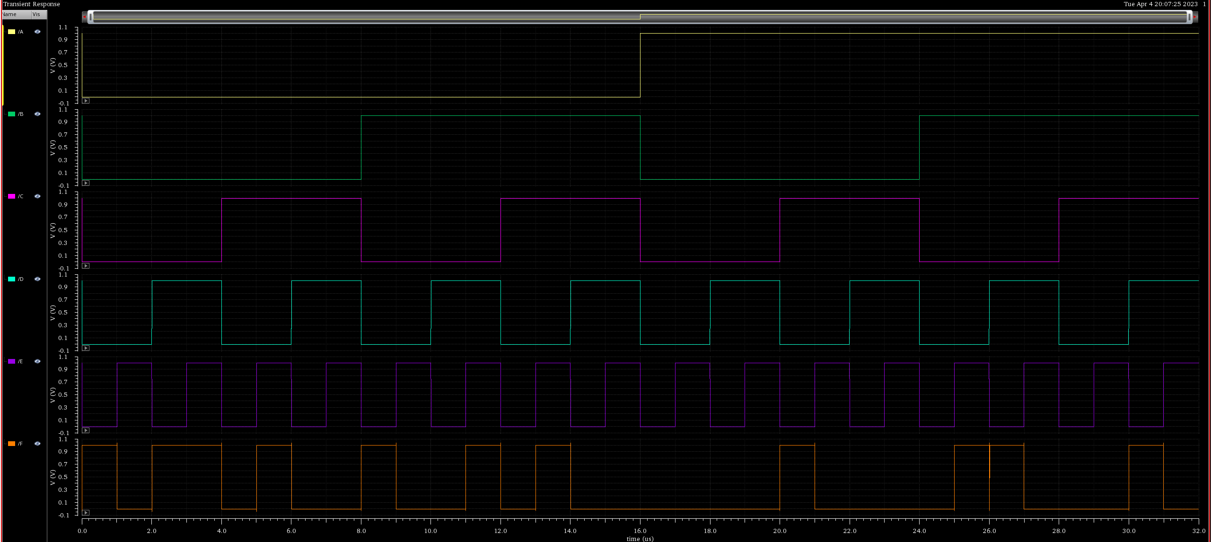
3. $F\left(A,B,C,D,E\right)= \sum{m\left(0,2,3,5,8,11,13,20,25,26,30\right)+ \sum{d(6,7,9,24)}}$
0
1
2
3
4
5
6
7
8
9
10
11
12
13
14
15
16
17
18
19
20
21
22
23
24
25
26
27
28
29
30
31

Slide 18
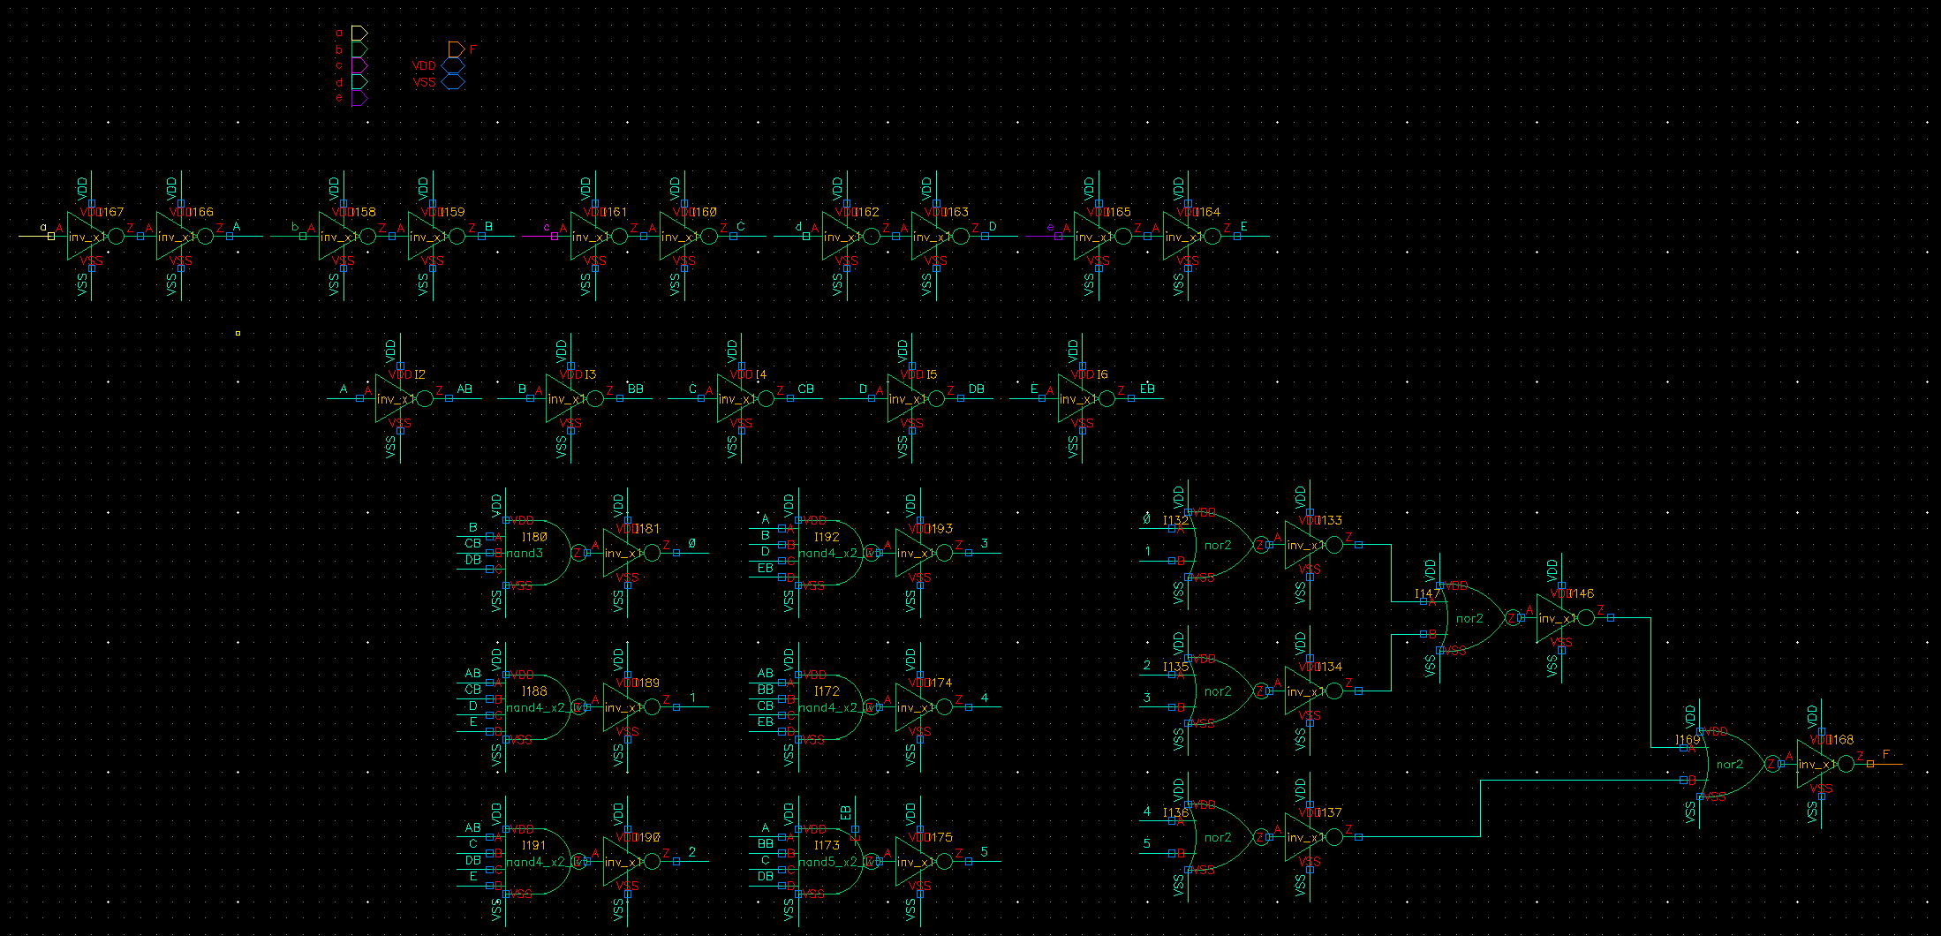
3. $F\left(A,B,C,D,E\right)= \sum{m\left(0,2,3,5,8,11,13,20,25,26,30\right)+ \sum{d(6,7,9,24)}}$
After Minimize (with Don’t care term)

Slide 19
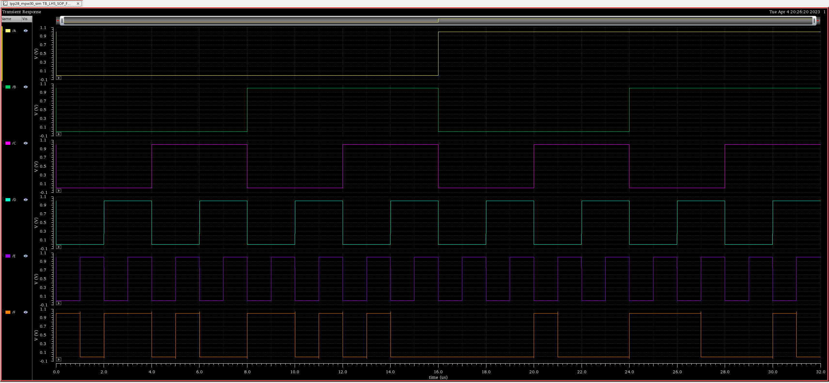
3. $F\left(A,B,C,D,E\right)= \sum{m\left(0,2,3,5,8,11,13,20,25,26,30\right)+ \sum{d(6,7,9,24)}}$
0
1
2
3
4
5
6
7
8
9
10
11
12
13
14
15
16
17
18
19
20
21
22
23
24
25
26
27
28
29
30
31

